Slide 1
Bacchus Case Study
CSD310-J308
Brittni Ray, Aaron Crose II, Shanika Love
(Team Bravo)

Slide 2
Bacchus Case Study Summary
Stan and Davis Bacchus inherited a winery and are looking to improve their products and customer service while incorporating new business methods. They have decided to keep all personnel in place across varying departments. Bacchus Winery sells three different types of wine–a merlot, a cabernet, a chablis, and a chardonnay. They receive shipments of supplies from three different suppliers; one for corks and bottles, one for labels and boxes, and one for vats and tubing. The owners are responsible for keeping track of these shipments for their winery’s inventory and would like to find an efficient method for keeping track of and ordering supplies. They would also like for distributors to be able to track their online orders.
The pair of owners would like to create a yearly snapshot of their business, and need the ability to pull certain information regarding the inventory, the distribution of wines, and the employees. Specifically, they need:
A month by month report showing if suppliers are delivering on time so they can determine any gaps between expected and actual delivery dates.
Information on if all their distributed wines are selling well, which wine is not selling, and which distributor carries which wine.
Information on how many hours each employee worked during the last four quarters.

Slide 3
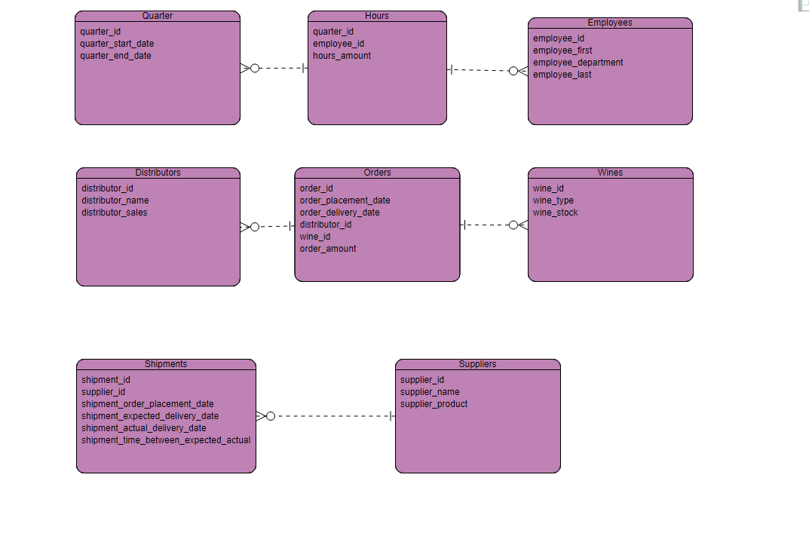
Finalized ERD

Slide 4
Descriptions of Reports Generated #1
For this first report, we chose to focus on the first of Davis and Stans first query, which was a report that shows whether or not suppliers are delivering their products on time so that they can determine any gaps between expected and actual delivery time. In that sense, we thought it made sense to produce a report that would track and Join both the shipment_IDs and supplier_IDs–just so we know who is sending what, along with the fields that will help us determine the gaps, which were shipment_expected_delivery_date, shipment_actual_delivery_date, and then a field that can calculate that difference easily, which is shipment_time_between_expected_actual which will give us a solid number, ideally, about how much the time difference between the expected and actual delivery date is.

Slide 5
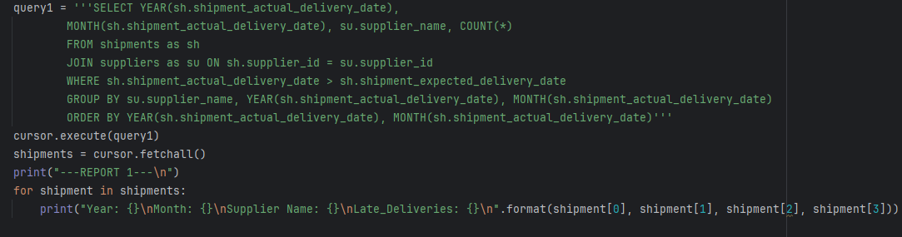
Report #1 - Shipment Query
query1 = '''SELECT YEAR(sh.shipment_actual_delivery_date),
MONTH(sh.shipment_actual_delivery_date), su.supplier_name, COUNT(*)
FROM shipments as sh
JOIN suppliers as su ON sh.supplier_id = su.supplier_id
WHERE sh.shipment_actual_delivery_date > sh.shipment_expected_delivery_date
GROUP BY su.supplier_name, YEAR(sh.shipment_actual_delivery_date), MONTH(sh.shipment_actual_delivery_date)
ORDER BY YEAR(sh.shipment_actual_delivery_date), MONTH(sh.shipment_actual_delivery_date)'''
cursor.execute(query1)
shipments = cursor.fetchall()
print("---REPORT 1---\n")

Slide 6
Descriptions of Reports Generated #2
For the second report, we went right down the list of another report Davis and Stan were looking to have, which had to do with their wine stock and distribution. They were interested in finding out which wines are selling well and which ones are selling not-so-well, along with which distributor is carrying which wine. For this, we decided to query the wine_type to determine what type of wine is tied to these other fields. Wine_stock to determine how much wine is where, the distributor_name to tie the distributor_sales and wine_stock together, and the order_amount so that we can determine how much is left via wine_stock.
Field ID: wine_type, wine_stock, distributor_name, distributor_sales, order_amount, distributor_id

Slide 7
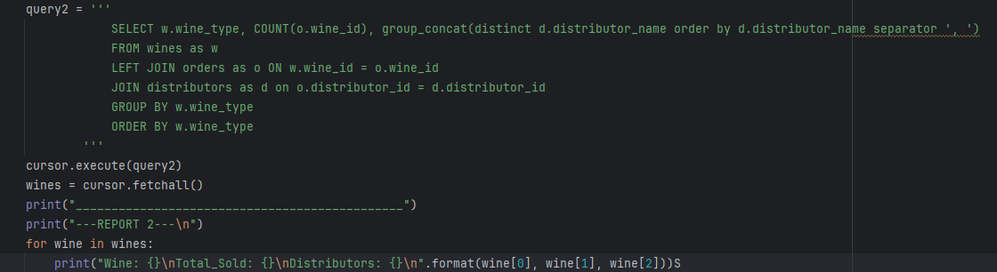
Report #2 - Wine Query
query2 = '''
SELECT w.wine_type, COUNT(o.wine_id), group_concat(distinct d.distributor_name order by d.distributor_name separator ', ')
FROM wines as w
LEFT JOIN orders as o ON w.wine_id = o.wine_id
JOIN distributors as d on o.distributor_id = d.distributor_id
GROUP BY w.wine_type
ORDER BY w.wine_type
'''
cursor.execute(query2)
wines = cursor.fetchall()
print("______________________________________________")
print("---REPORT 2---\n")
for wine in wines:
print("Wine: {}\nTotal_Sold: {}\nDistributors: {}\n".format(wine[0], wine[1], wine[2]))

Slide 8
Descriptions of Reports Generated #3
Finally, for report number three, we chose to create a report for the final questions that Davis and Stan had, which was about employees. Specifically, how many hours each employee had worked during the last four quarters. Therefore, we first chose employee_id, employee_first, and employee_last as fields to tie the hours to a specific employee. Then, the hours_amount field to get that number of hours worked, along with identifiers to tell us what quarter we are in, which are the quarter_id, quarter_start_date, and quart_end_date to paint a picture of what employee worked what amount of hours during the last four quarters.
Field ID: employee_id, hours_amount, quarter_id, quarter_start_date, quarter_end_date, employee_first, employee_last

Slide 9
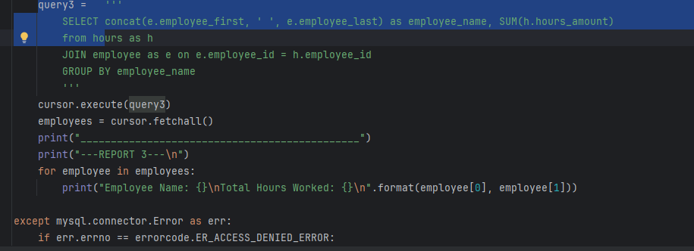
Report #3 - Employee Query

Slide 10
Assumptions Made About Case Study
One of our initial assumptions was defining the difference between what we see as ‘shipments’, ‘suppliers’, and ‘orders’. We had to spend some time defining those since it was getting a little confusing at first, but ultimately decided that ‘suppliers’ are the ones Bacchus Winery is receiving ‘shipments’ from for corks, bottles, etc. ‘Orders’ are orders placed by the distributors who want to distribute the wine.

